Slide 1


An Industrial Training Presentation
Prepared By:
Meet Makavana (201903103510381)
Gopika Rupapara (202003103520101)
Dinal Bhimani (202003103520105)
B.Tech. (8th Semester) (CE)
CGPIT.
Guided By:
Mr.Fenil Khatiwala
Assistant Professor (CE)
CGPIT.

Slide 2
Outline
2
Company Profile
Timeline Chart
Training Work
Project Introduction
Project Objective
Technologies/Platform
Modules of Project
Future Work
References

Slide 3
Company Profile
3
No of Employees:- 50
Technologies:- Mobile development(Android/iOS/Flutter), web development(.NET), website design(Html/CSS).
Address:- 214, Wood Square, Opp. TGB Restaurant, LP Savani Rd, Surat, Gujarat 395009
Contact :- 63510 44229
Email:- Carrer@forefrontinfotech.com
Starting Year:- 2016

Slide 4



Timeline Chart
4
knowledge about how to .NET & AJAX work.
MS SQL
Implementation
HTML/ CSS
Week 1
2&3
4&5
6
7
8
Introduction
JavaScript
MVC

Slide 5
Training Work
5
Introduction
The .NET is a software framework. It is developed by Microsoft. It includes a large library and also provides language interoperability across some programming languages.
Language interoperability refers to the capability of two different languages to interact and operate on the same data structures.
Design Features of .NET Framework
Interoperability
Common Language Runtime engine (CLR)
Language independence
Base Class Library
Simplified deployment
Security
Portability

Slide 6
Training Work
6
HTML:- Hyper Text Markup Language
HTML stands for Hyper Text Markup Language.
HTML is the standard markup language for creating Web pages.
HTML describes the structure of a Web page.
Tags:-
HTML, head, title, body, bgcolor, text, font, color, p, tt, em, b, i, u, pre, sub, sup, h1 to h6, align, hr, size, img, src, alt, width, height.

Slide 7
Training Work
7
CSS:- CASCADING STYLE SHEETS
CSS stands for Cascading Style Sheets.
CSS describes how HTML elements are to be displayed on screen, paper, or in other media.
CSS saves a lot of work. It can control the layout of multiple web pages all at once.
External stylesheets are stored in CSS files.
CSS is used to define styles for your web pages, including the design, layout and variations in display for different devices and screen sizes.

Slide 8
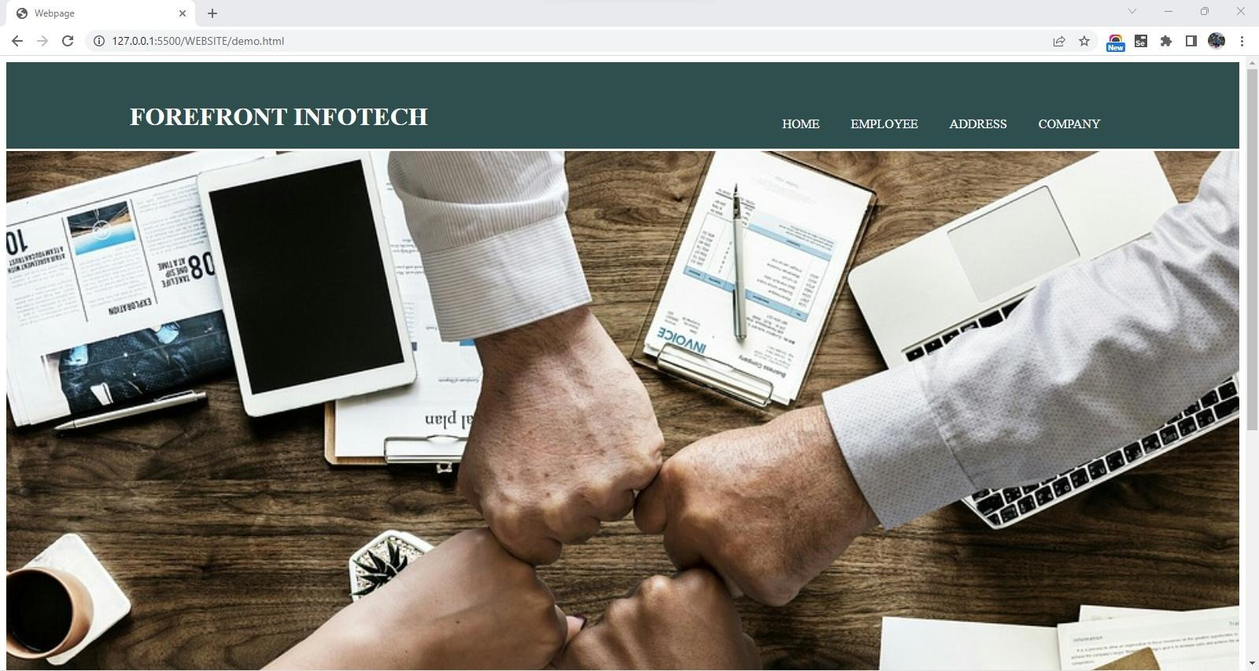
Address Book :- Home
8

Slide 9
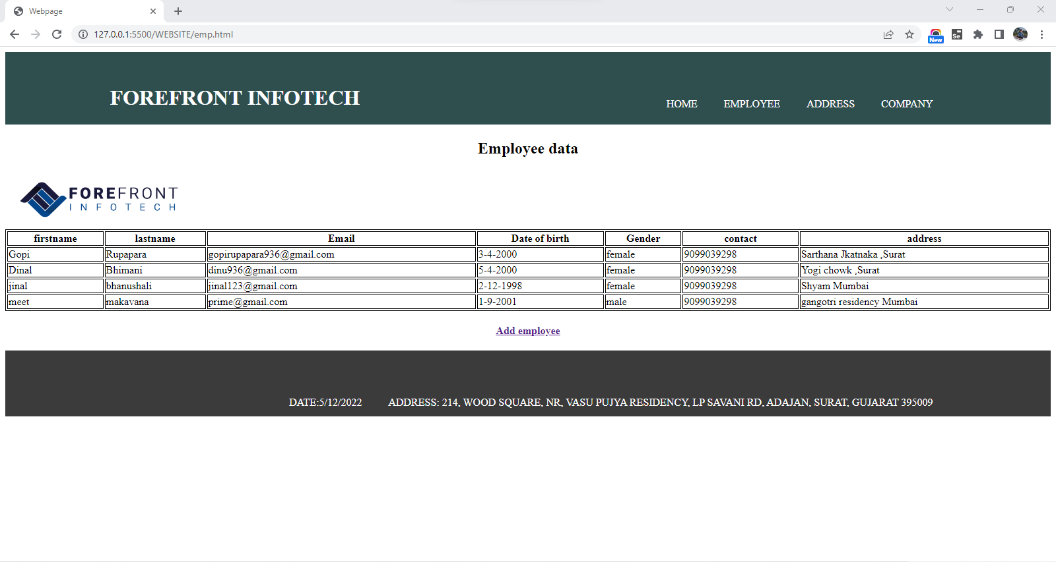
Employee :-
9

Slide 10
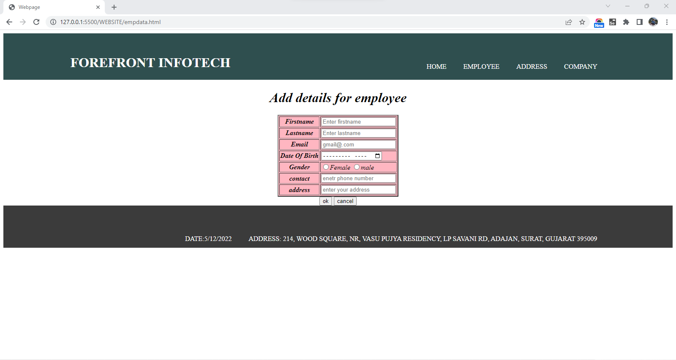
Continue…
10

Slide 11
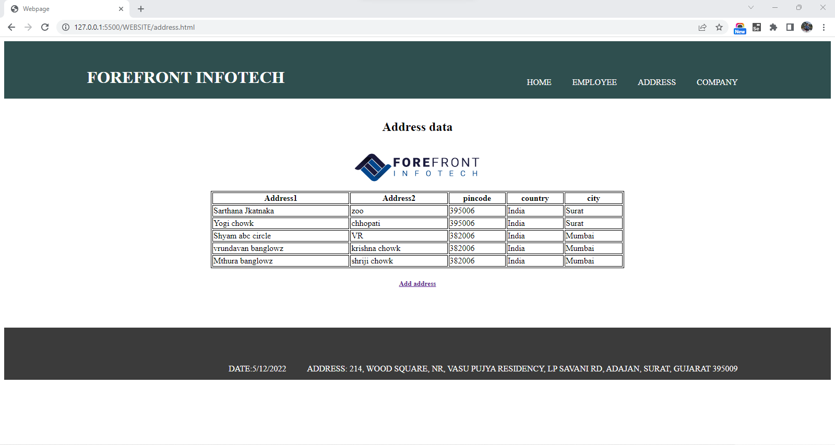
Address :-
11

Slide 12
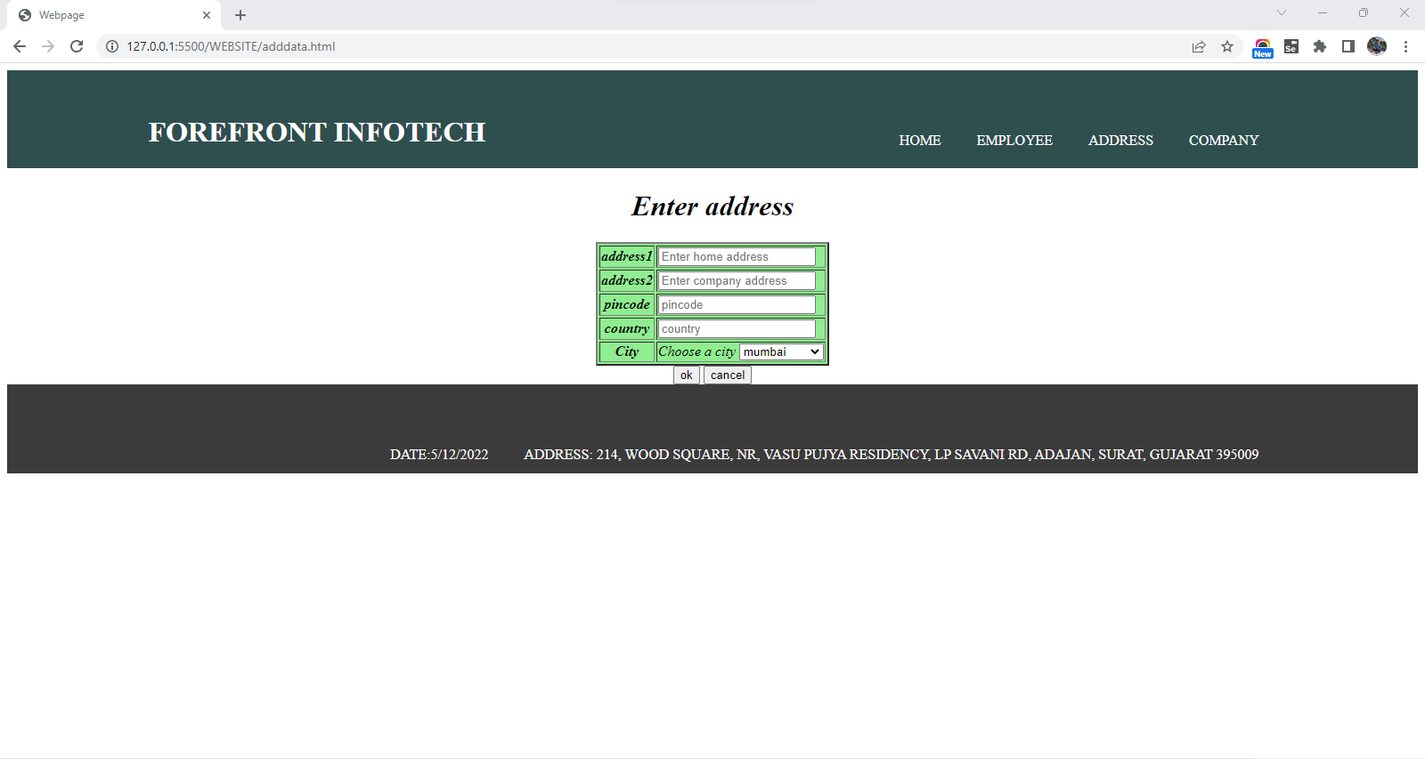
Continue…
12

Slide 13
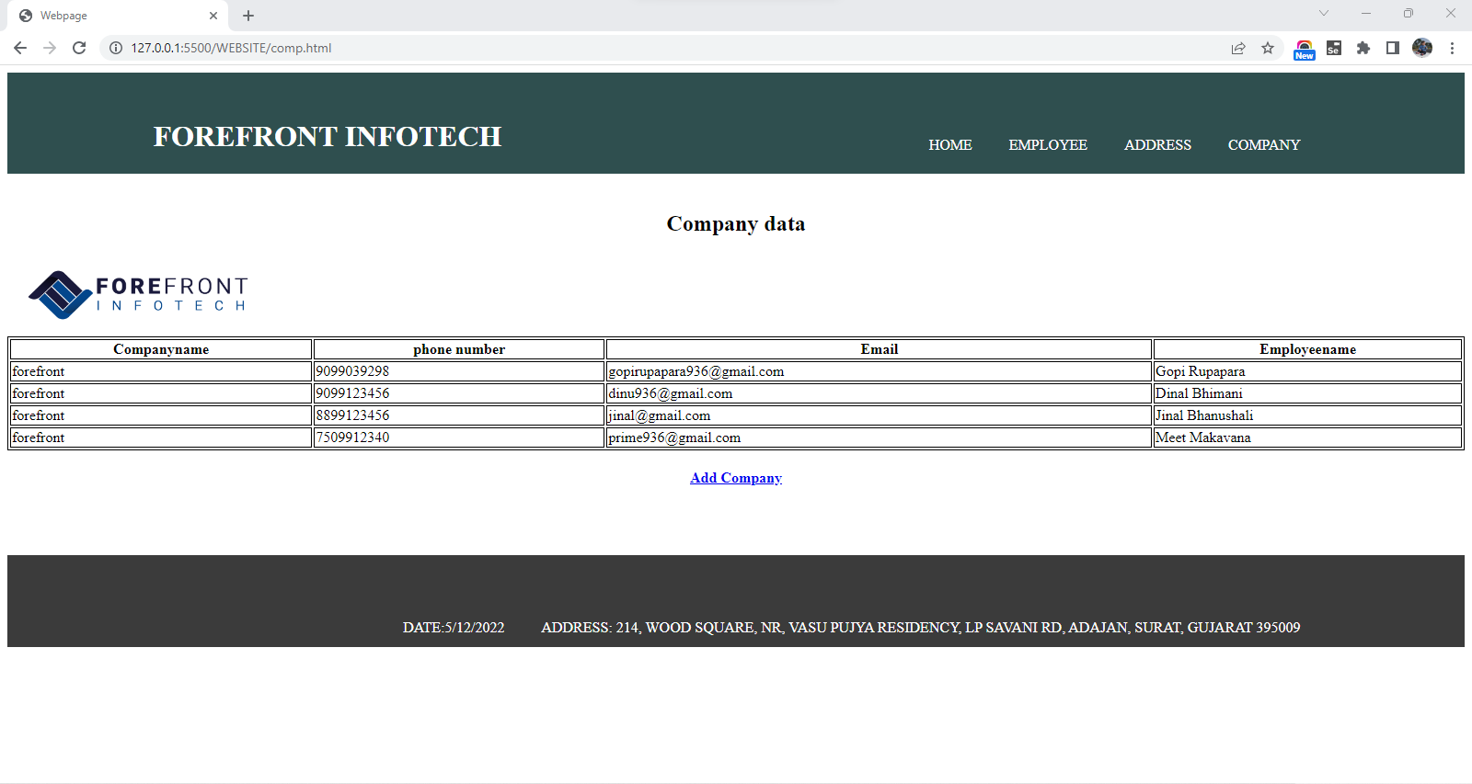
Company :-
13

Slide 14
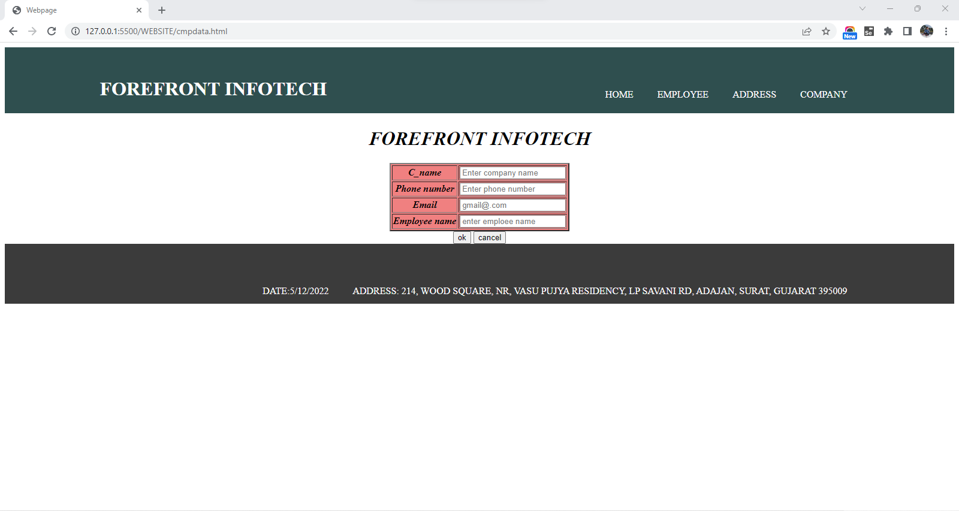
Continue…
14

Slide 15
Training Work
15
JavaScript
JavaScript (JS) is a lightweight, interpreted, or just-in-time compiled programming language with first-class functions.
While it is most well-known as the scripting language for Web pages, many non-browser environments also use it, such as Node.js, Apache Couch DB, and Adobe Acrobat.
JavaScript is a prototype-based, multi-paradigm, single-threaded, dynamic language, supporting object-oriented, imperative, and declarative styles.
JavaScript's dynamic capabilities include runtime object construction, variable parameter lists, function variables, dynamic script creation, object introspection and source-code recovery.

Slide 16

Generate Countdown :-
16

Slide 17
Hide-Show Text :-
17

Slide 18
Working Button Like Lift :-
18

Slide 19
Training Work
19
MS SQL
Microsoft SQL Server is a relational database management system (RDBMS) that supports a wide variety of transaction processing, business intelligence, and analytics applications in corporate IT environments.
Microsoft SQL Server is one of the three market-leading database technologies, along with Oracle Database and IBM.
The data management side, Microsoft SQL Server includes SQL Server Integration Services, SQL Server Data Quality Services, and SQL Server Master Data Services.

Slide 20
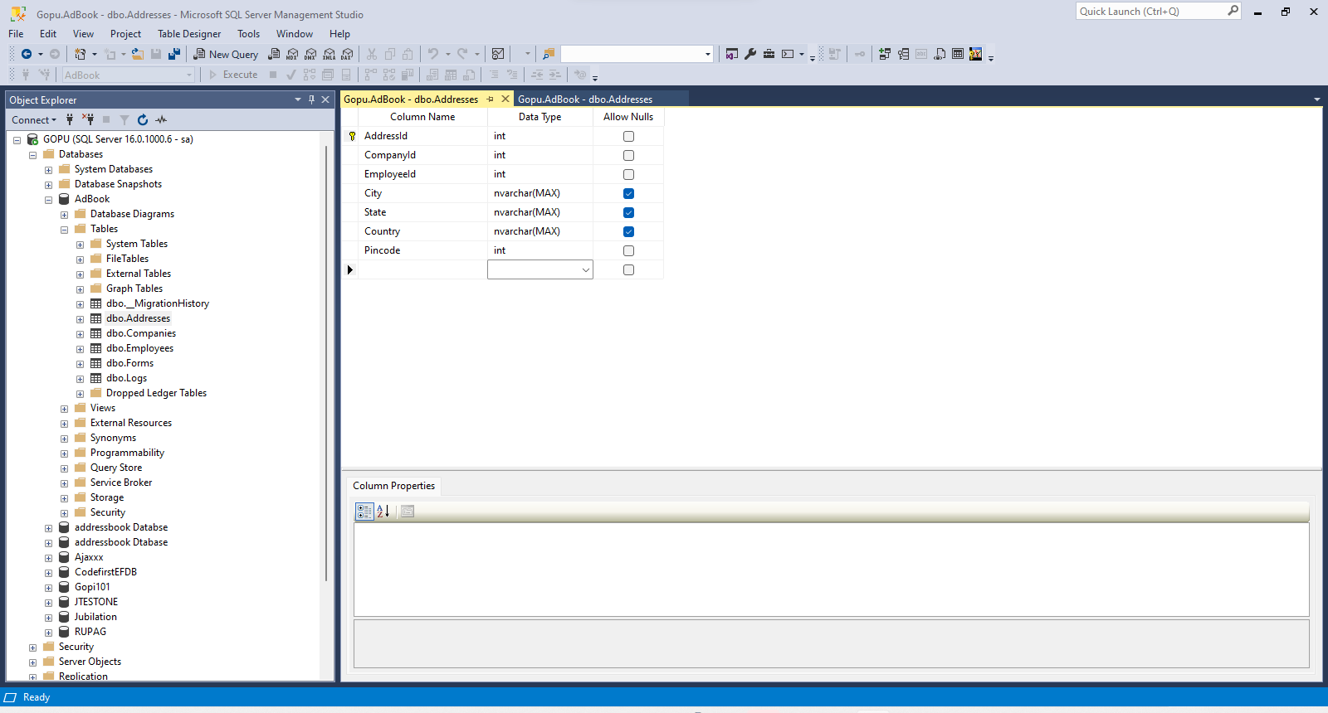
Create Tables:-
;-
20

Slide 21
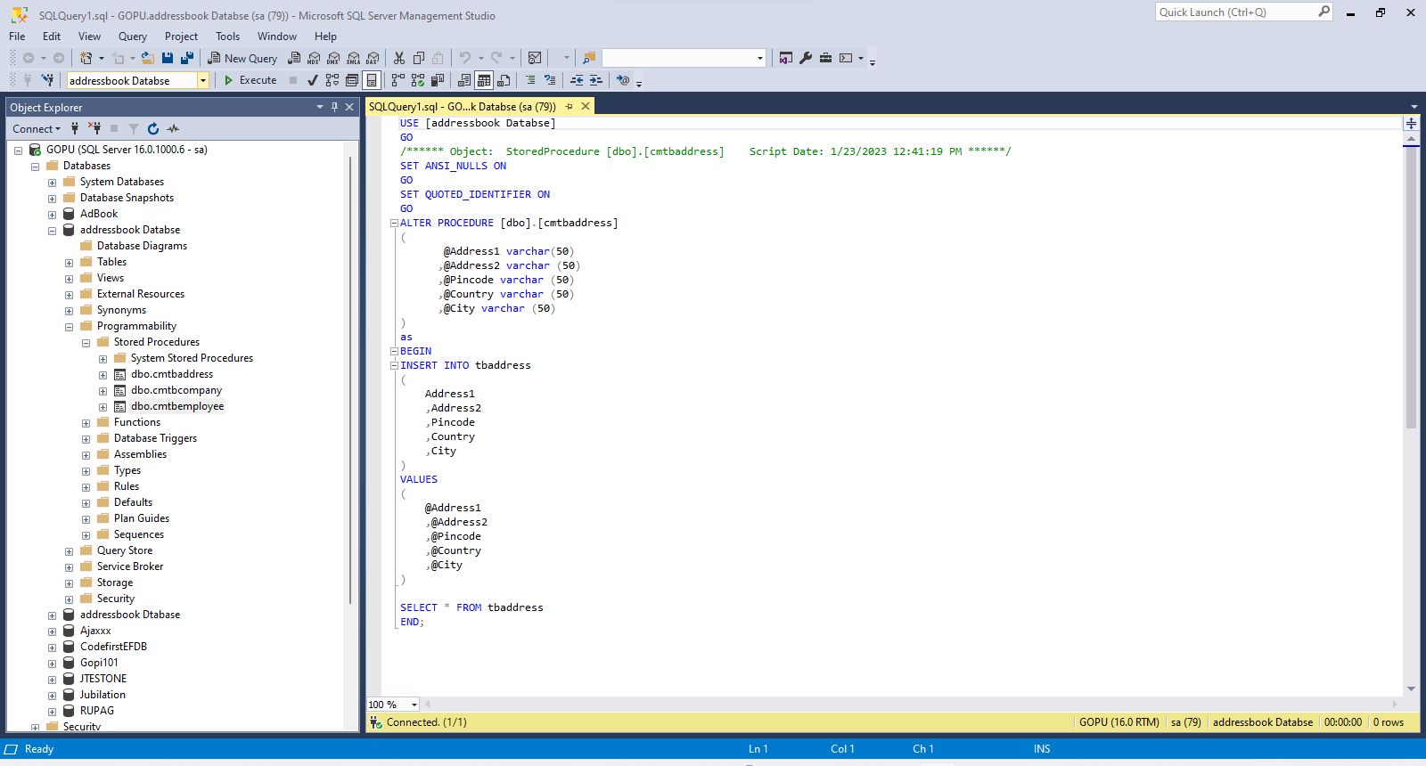
Create Store-Procedure :-
…
21

Slide 22
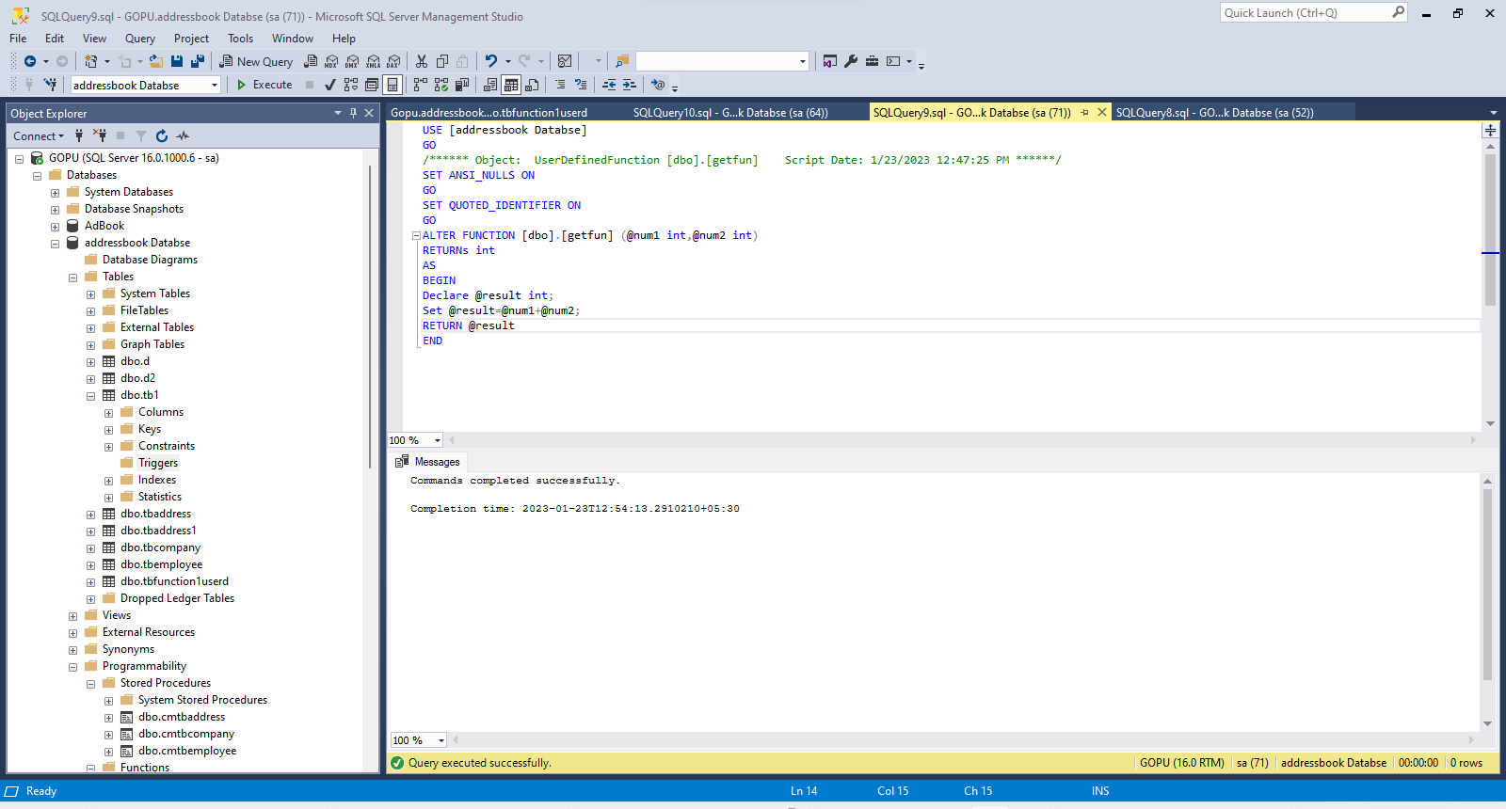
Create Function:-
22

Slide 23
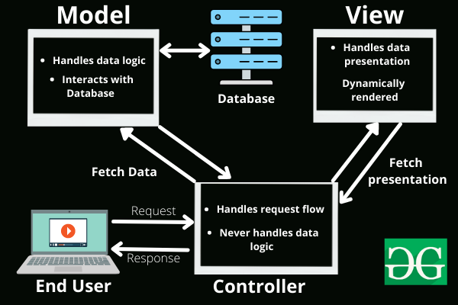
Training Work
23
MVC:- ( Model-View-Controller)

Slide 24
Training Work
24
The Model-View-Controller (MVC) framework is an architectural/design pattern that separates an application into three main logical components Model, View, and Controller.
Each architectural component is built to handle specific development aspects of an application.
It isolates the business logic and presentation layer from each other.
It was traditionally used for desktop graphical user interfaces . Nowadays, MVC is one of the most frequently used industry-standard web development frameworks to create scalable and extensible projects.
It is also used for designing mobile apps.

Slide 25
Training Work
25
Features of MVC :
It provides a clear separation of business logic, Ul logic, and input logic.
It offers full control over your HTML and URLs which makes it easy to design web application architecture.
It is a powerful URL-mapping component using which we can build applications that have comprehensible and searchable URLs.
It supports Test Driven Development (TDD).

Slide 26
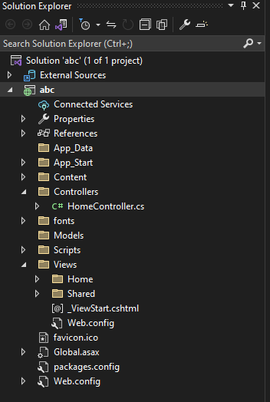
Continue…
26

Slide 27
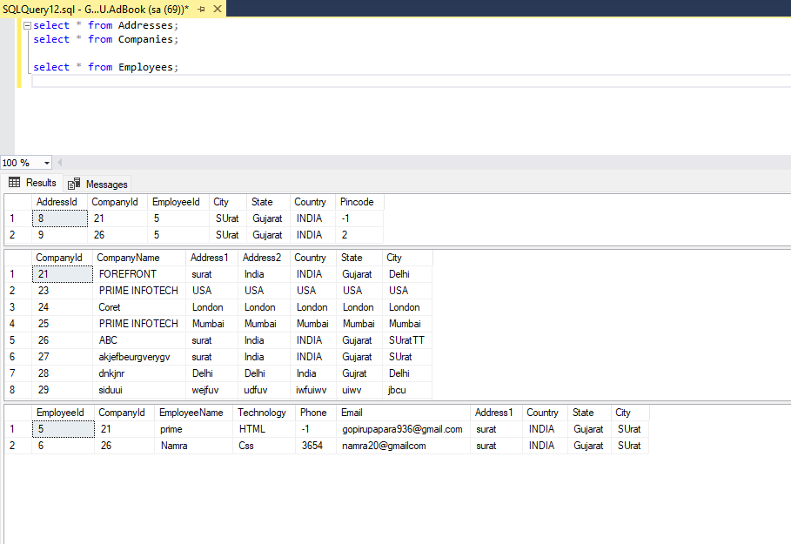
Create Dynamic Address-Book :-
27

Slide 28
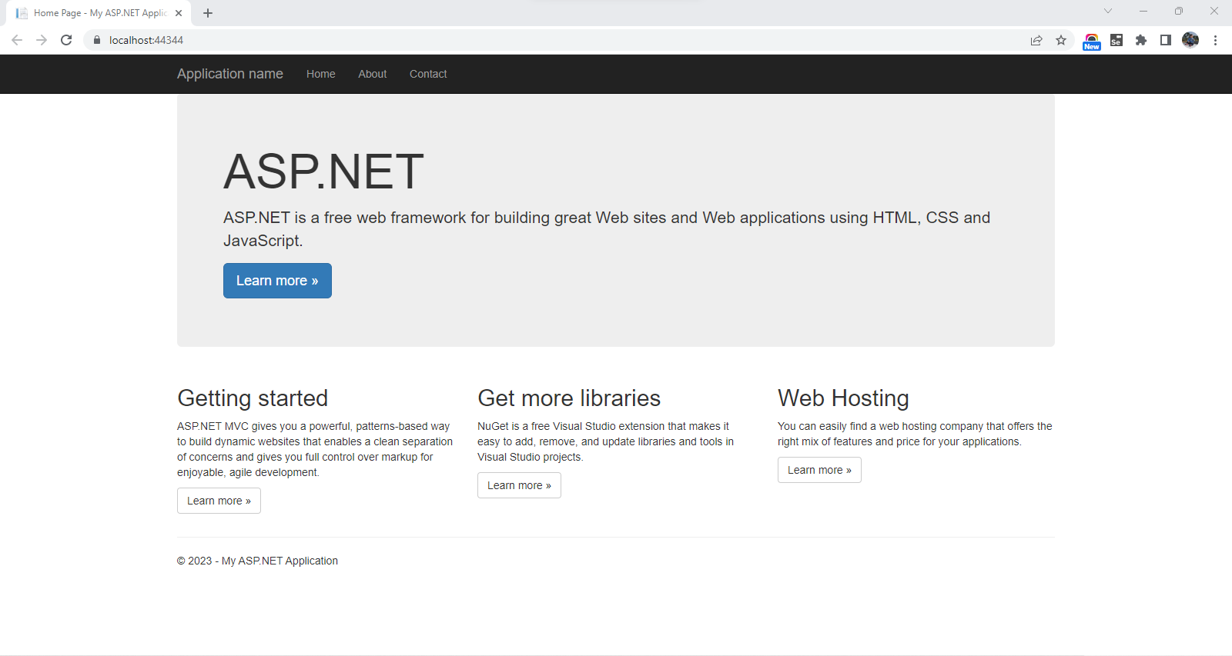
Continue…
28

Slide 29
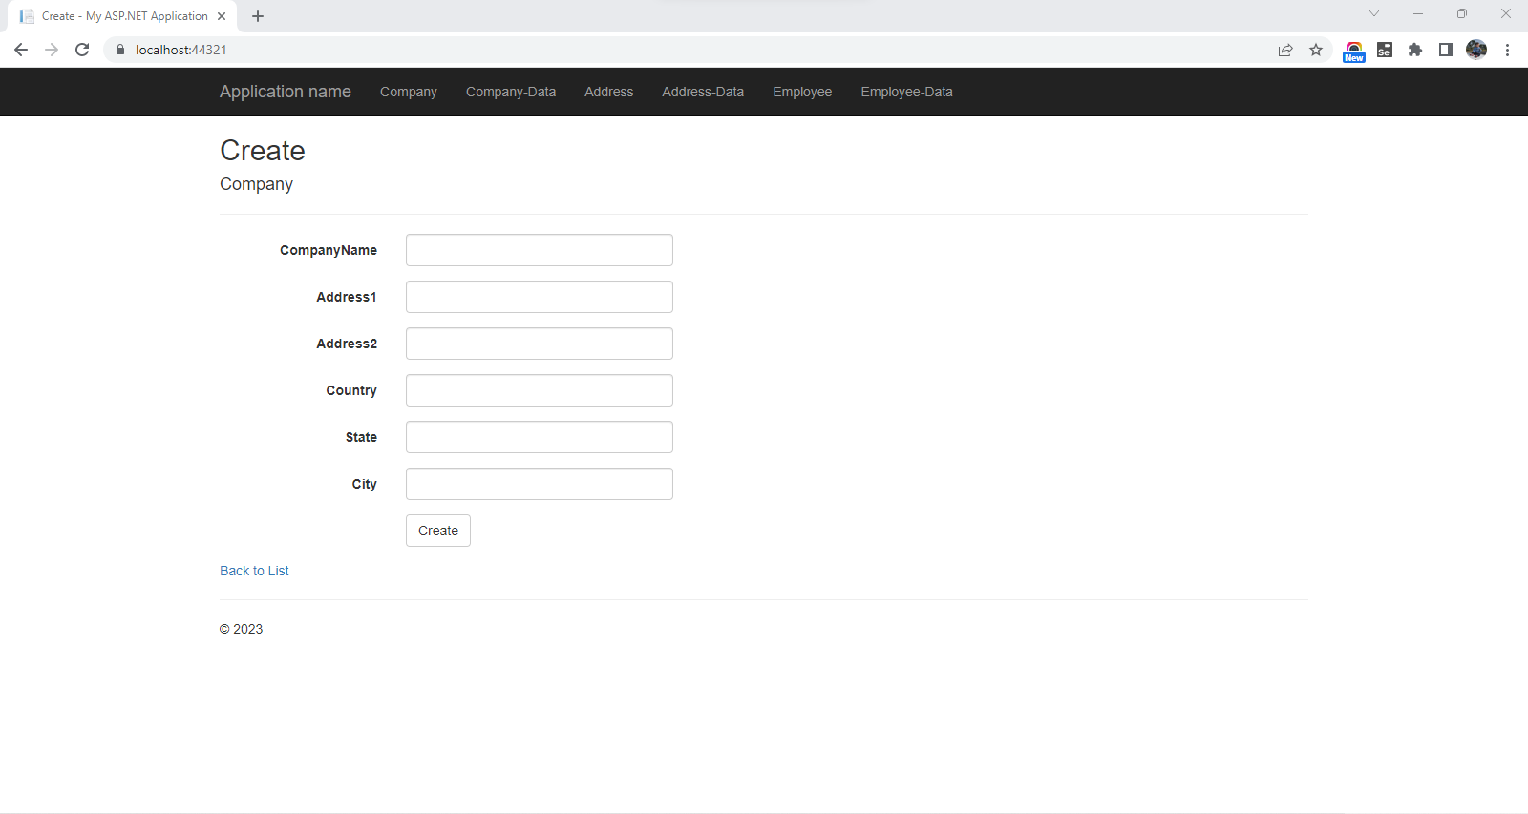
Continue…
29

Slide 30
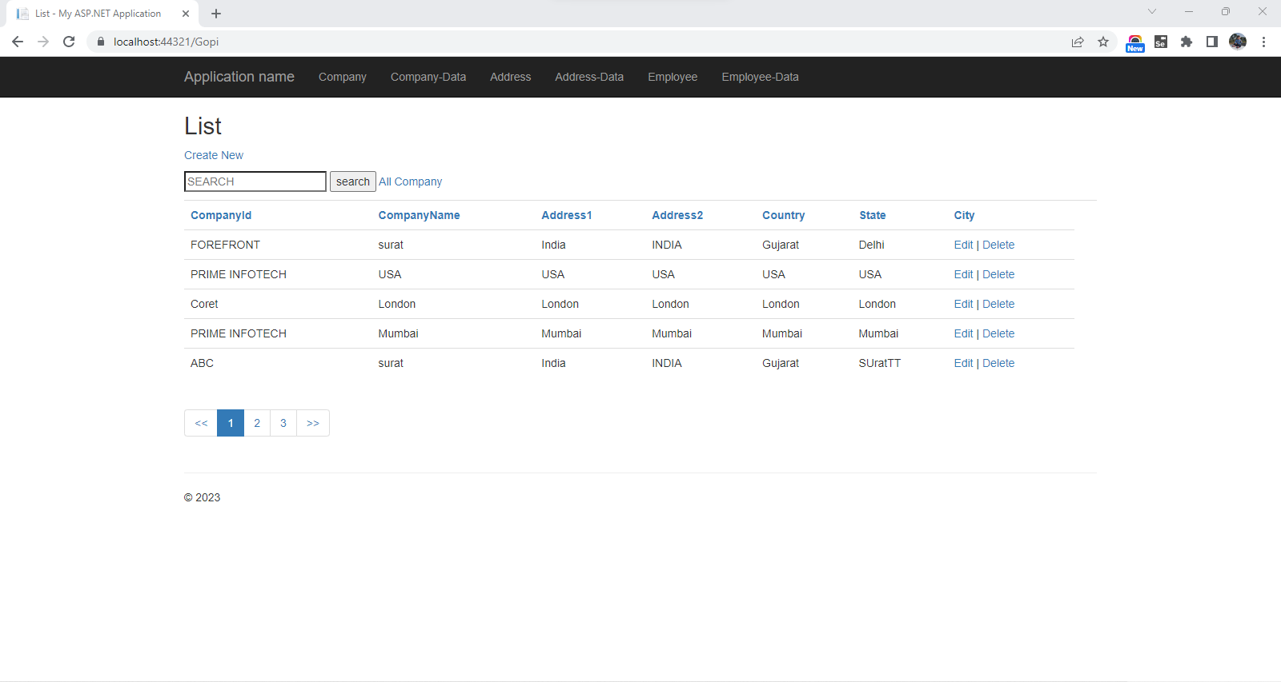
Continue…
30

Slide 31
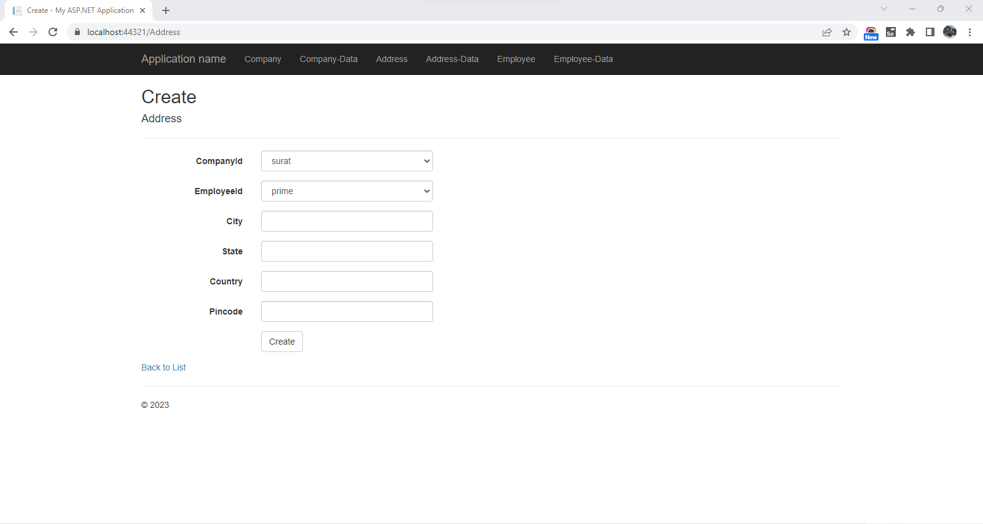
Continue…
31

Slide 32
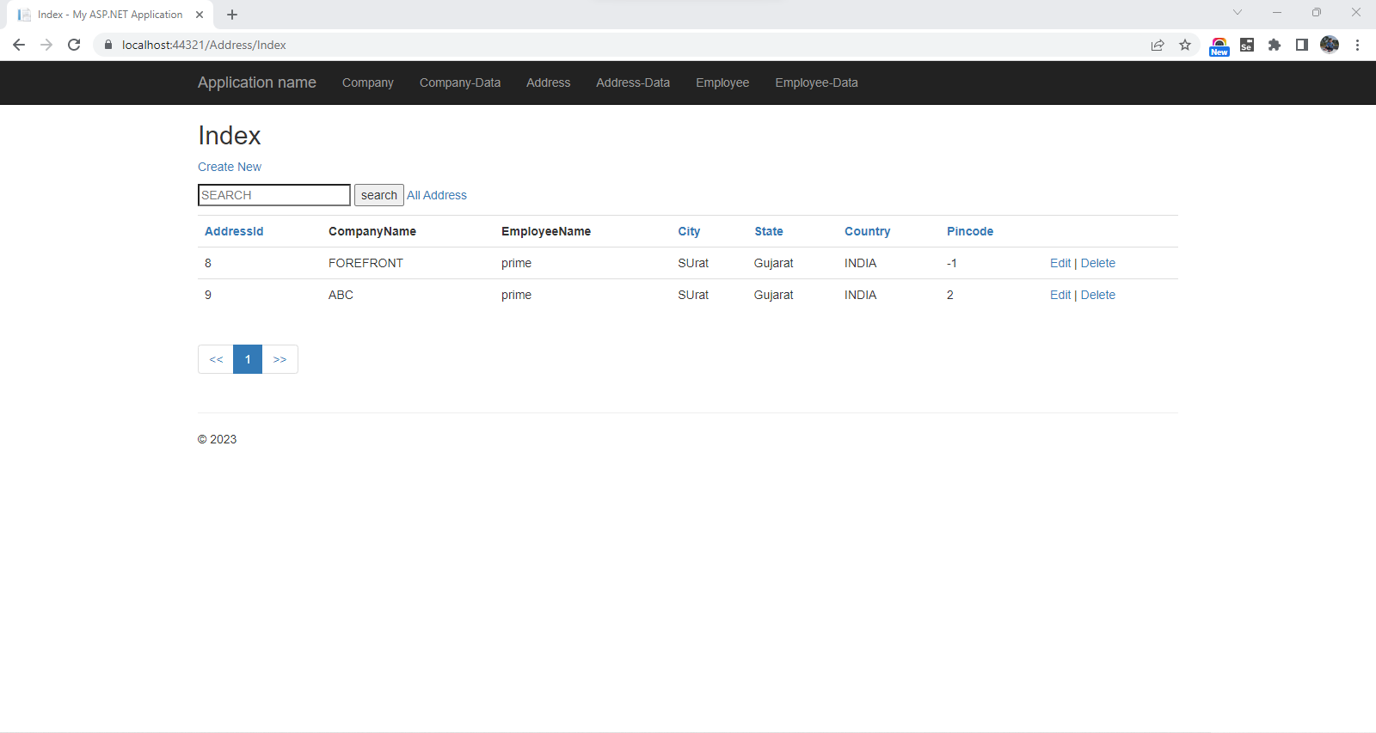
Continue…
32

Slide 33
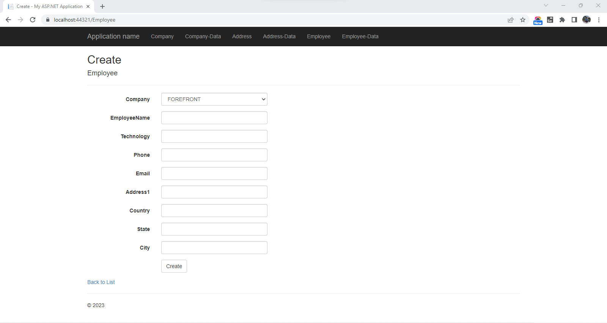
Continue…
33

Slide 34
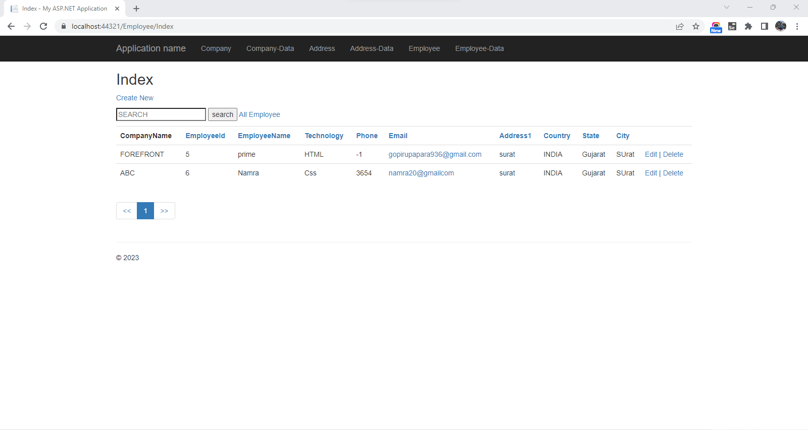
Continue…
34

Slide 35
Future Work
39
Develop a Wedding planner website

Slide 36
References
40
https://code.tutsplus.com/tutorials/design-and-code-your-first-website-in-easy-to-understand-steps--net-6062
https://www.w3schools.com/jquery/
https://www.w3schools.com/js/js_ajax_intro.asp
https://www.tutorialsteacher.com/mvc

Slide 37
41
Thank You

